Slide 1




By : Ahmed .M. S

Slide 2



SLIDE 1

Slide 3
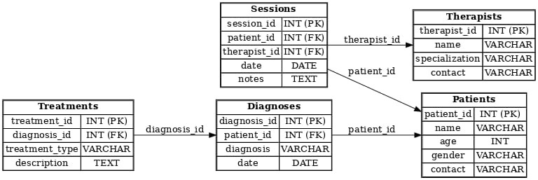
SCHEMA
PROJECT

Slide 4
contact VARCHAR(100)
);
CREATE TABLE Sessions (
session_id INT PRIMARY KEY,
patient_id INT,
therapist_id INT,
date DATE,
notes TEXT,
FOREIGN KEY (patient_id) REFERENCES Patients(patient_id),
FOREIGN KEY (therapist_id) REFERENCES Therapists(therapist_id)
);
CREATE TABLE Diagnoses (
diagnosis_id INT PRIMARY KEY,
patient_id INT,
diagnosis VARCHAR(200),
date DATE,
FOREIGN KEY (patient_id) REFERENCES Patients(patient_id)
);
CREATE TABLE Treatments (
treatment_id INT PRIMARY KEY,
diagnosis_id INT,
treatment_type VARCHAR(100),
description TEXT,
FOREIGN KEY (diagnosis_id) REFERENCES Diagnoses(diagnosis_id)
);
CODING
SLIDE 3
Create database mental_health;
CREATE TABLE Patients (
patient_id INT PRIMARY KEY,
name VARCHAR(100),
age INT,
gender VARCHAR(10),
contact VARCHAR(100)
);
CREATE TABLE Therapists (
therapist_id INT PRIMARY KEY,
name VARCHAR(100),
specialization VARCHAR(100),
);
CREATE TABLE Sessions (
session_id INT PRIMARY KEY,
patient_id INT,
therapist_id INT,
date DATE,
notes TEXT,
FOREIGN KEY (patient_id) REFERENCES Patients(patient_id),
FOREIGN KEY (therapist_id) REFERENCES Therapists(therapist_id)
);
CREATE TABLE Diagnoses (
diagnosis_id INT PRIMARY KEY,
patient_id INT,
diagnosis VARCHAR(200),
date DATE,
FOREIGN KEY (patient_id) REFERENCES Patients(patient_id)
);
CREATE TABLE Treatments (
treatment_id INT PRIMARY KEY,
diagnosis_id INT,
treatment_type VARCHAR(100),
description TEXT,
FOREIGN KEY (diagnosis_id) REFERENCES Diagnoses(diagnosis_id)
);

Slide 5
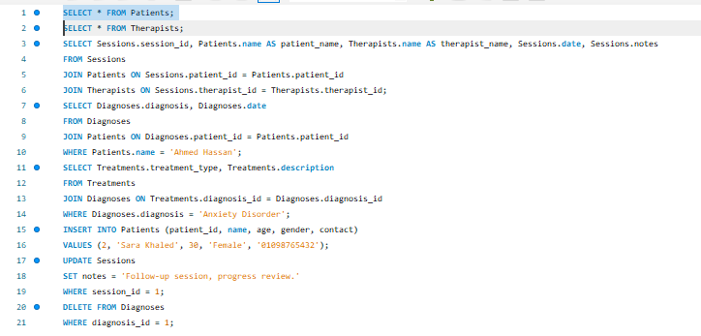
QURES

Slide 6
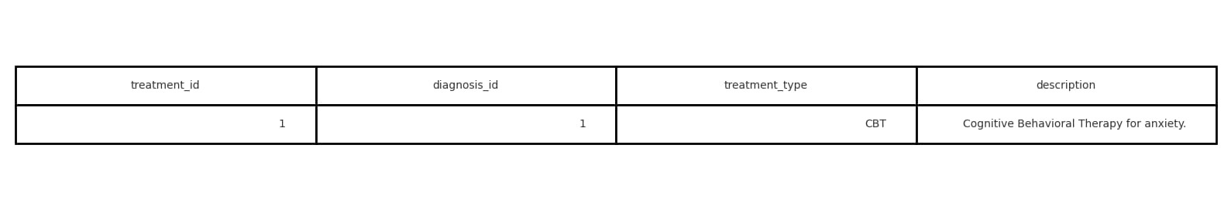
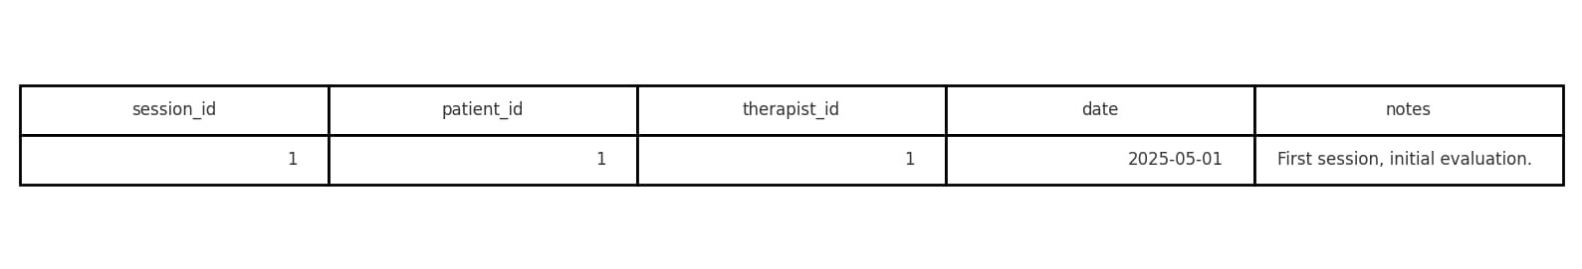
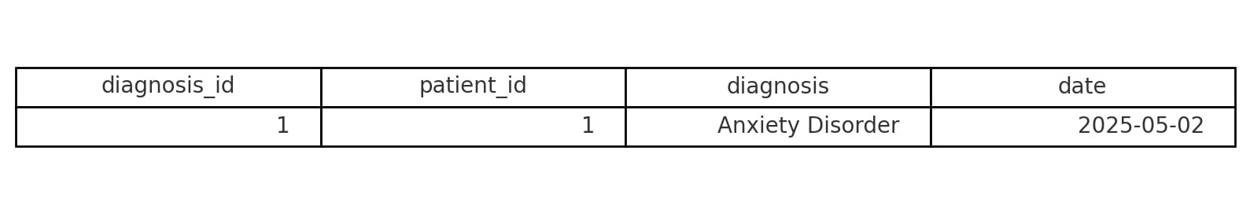
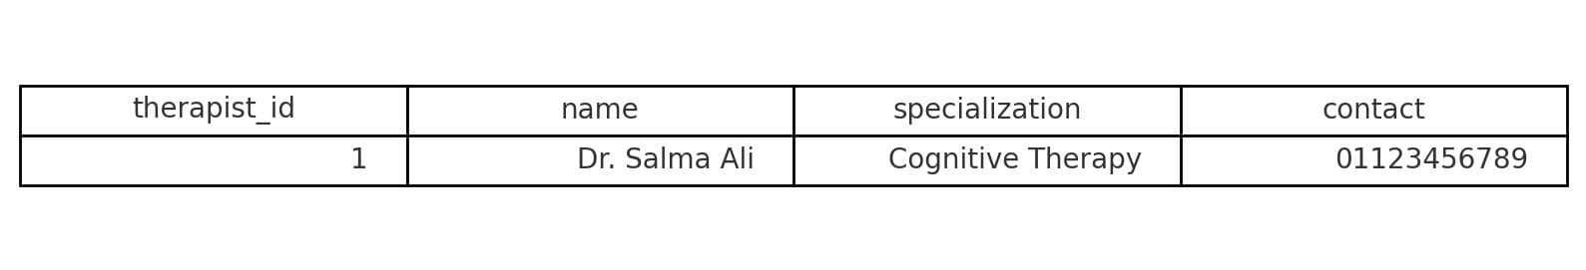
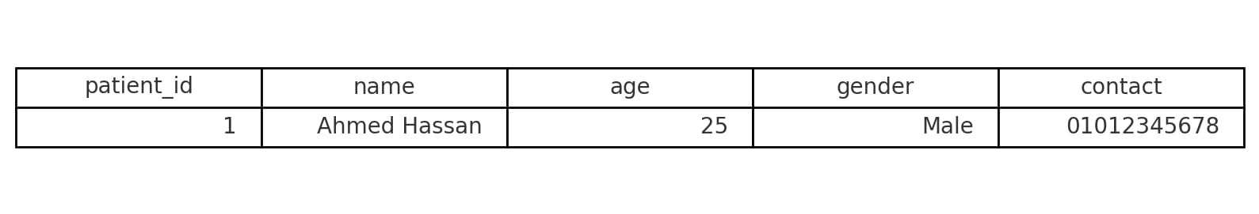
Tables

Slide 7




Slide 8


Slide 9
Thank you
MLSA
By : Ahmed .M. S

